Slide 1
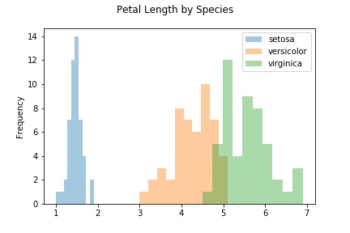
The main purpose of histograms are to visually show the density of the data points within small intervals.
The most important part of a histogram is to correctly choose a ‘resolution’ or thickness of a column to enclose multiple data points but few enough to show the distribution of the data points.

